Slide 1

WIPRO NGA Program – Datacenter Batch5
Capstone Project Presentation – 06 April 2024
Project Title Here – Installation of centOS-7 & LVM configuration
Presented by - Kishor Chandra Sahoo
www.rpsconsulting.in

Slide 2
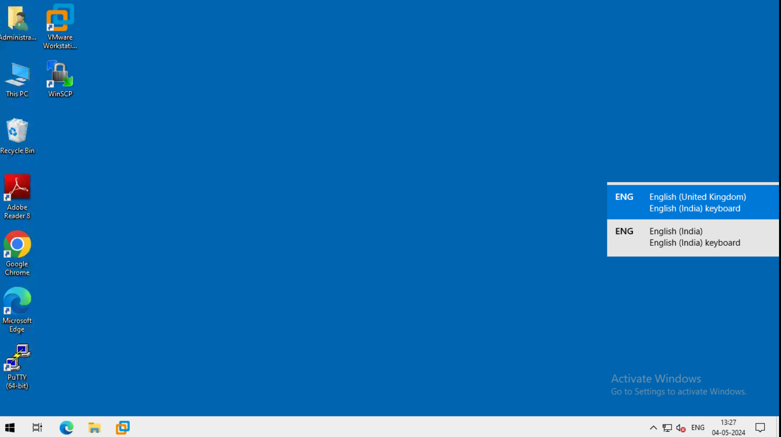
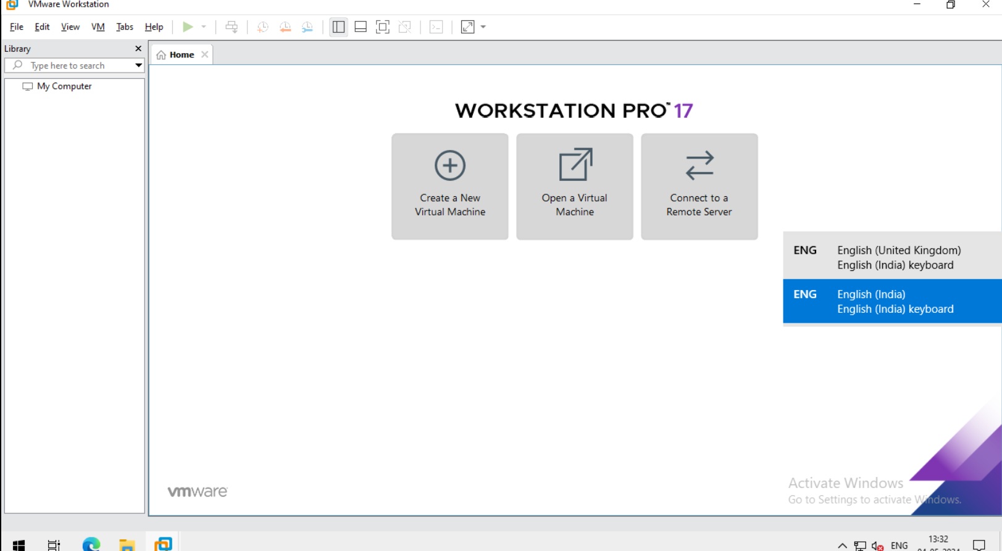

Slide Title
Here is the first page of cloud Environment.
Here is the first step of installation and open view of vmware.

Slide 3
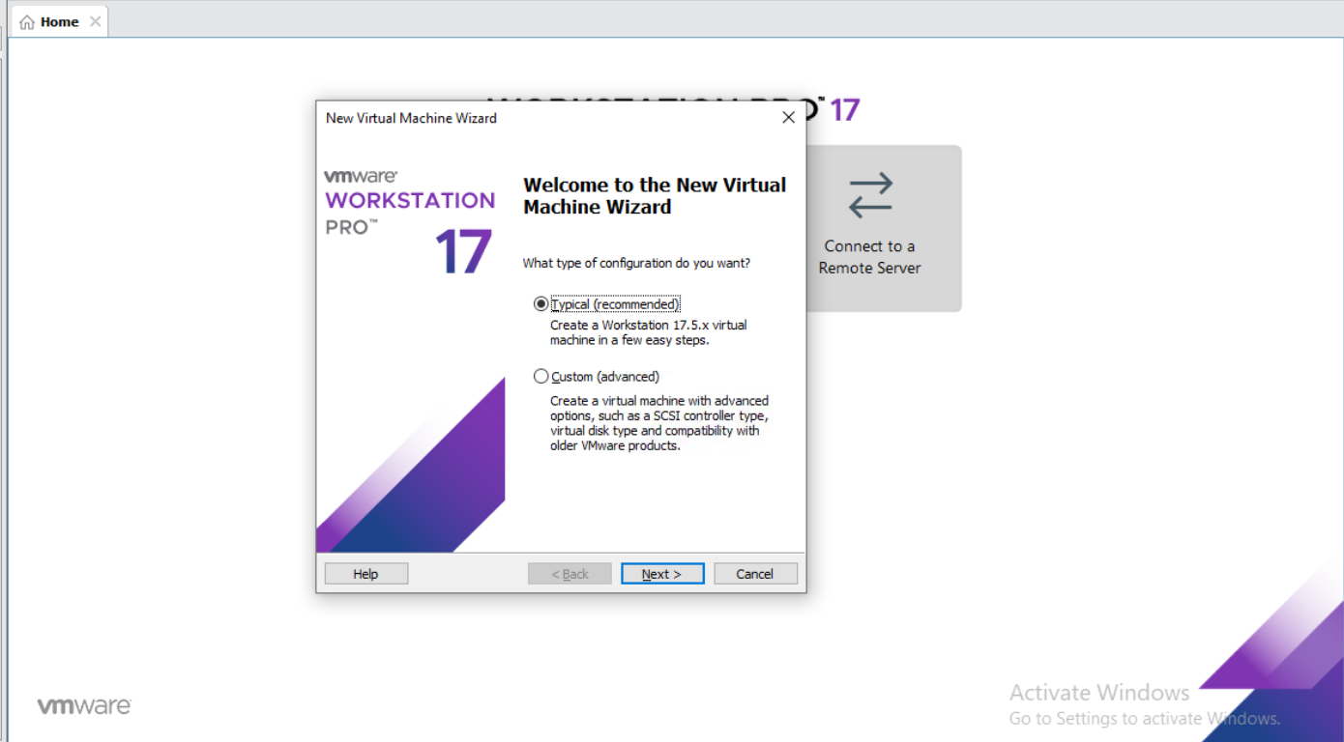
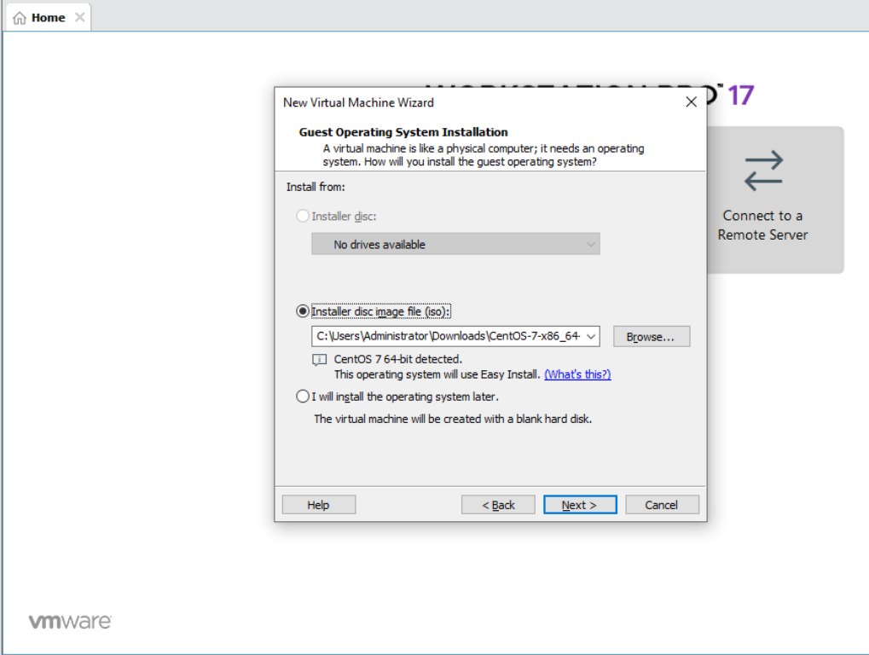
After clicking Create a new virtual machine ,Then we have this interface.
In this step choose typical.
After Clicking Typical this is the next step , In here we browse CentOS7 -7 Click Next.

Slide 4
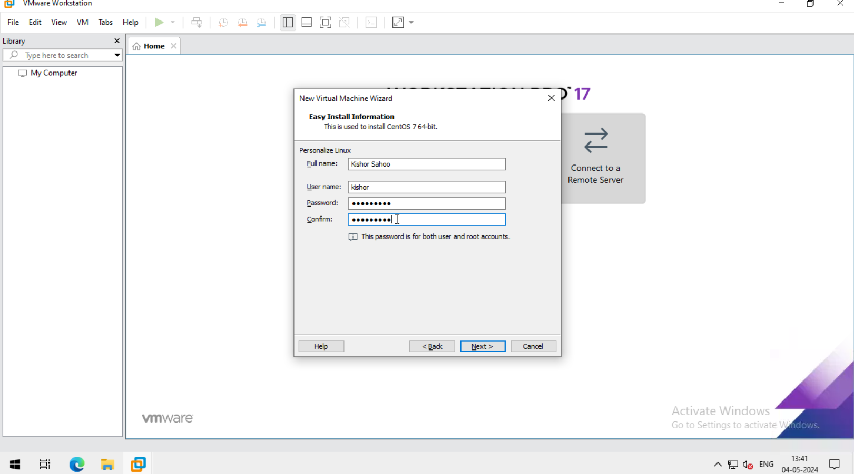
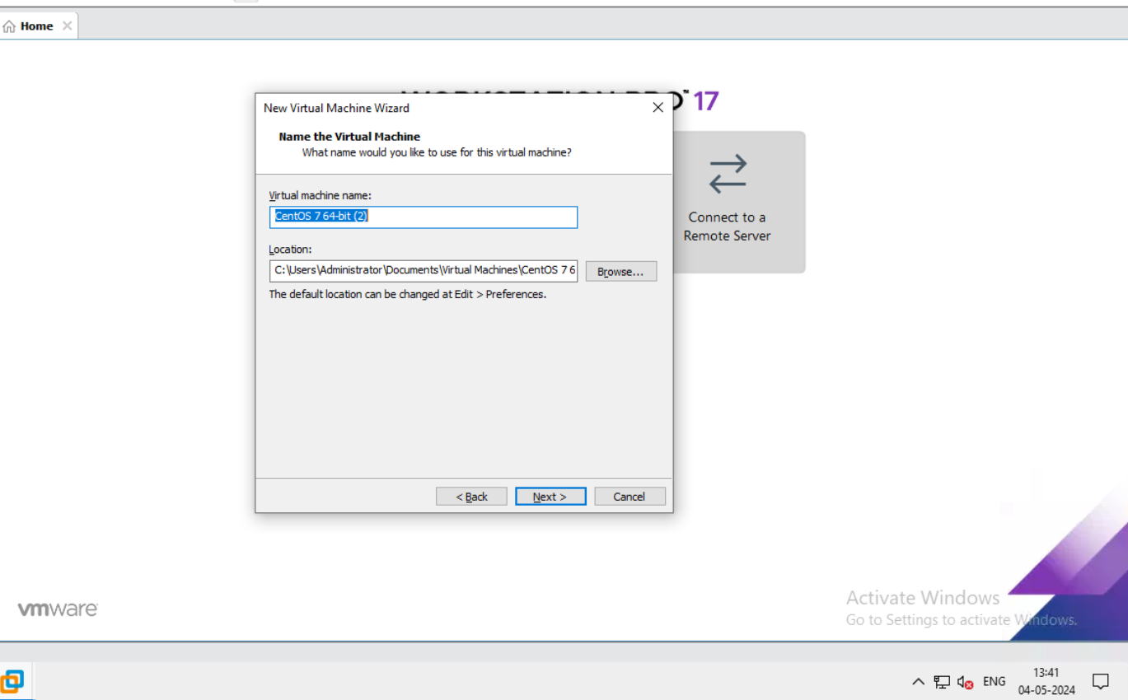
After browse next step is assign full name, user name & password.
Then click next.
After that give the name of the virtual machine.

Slide 5
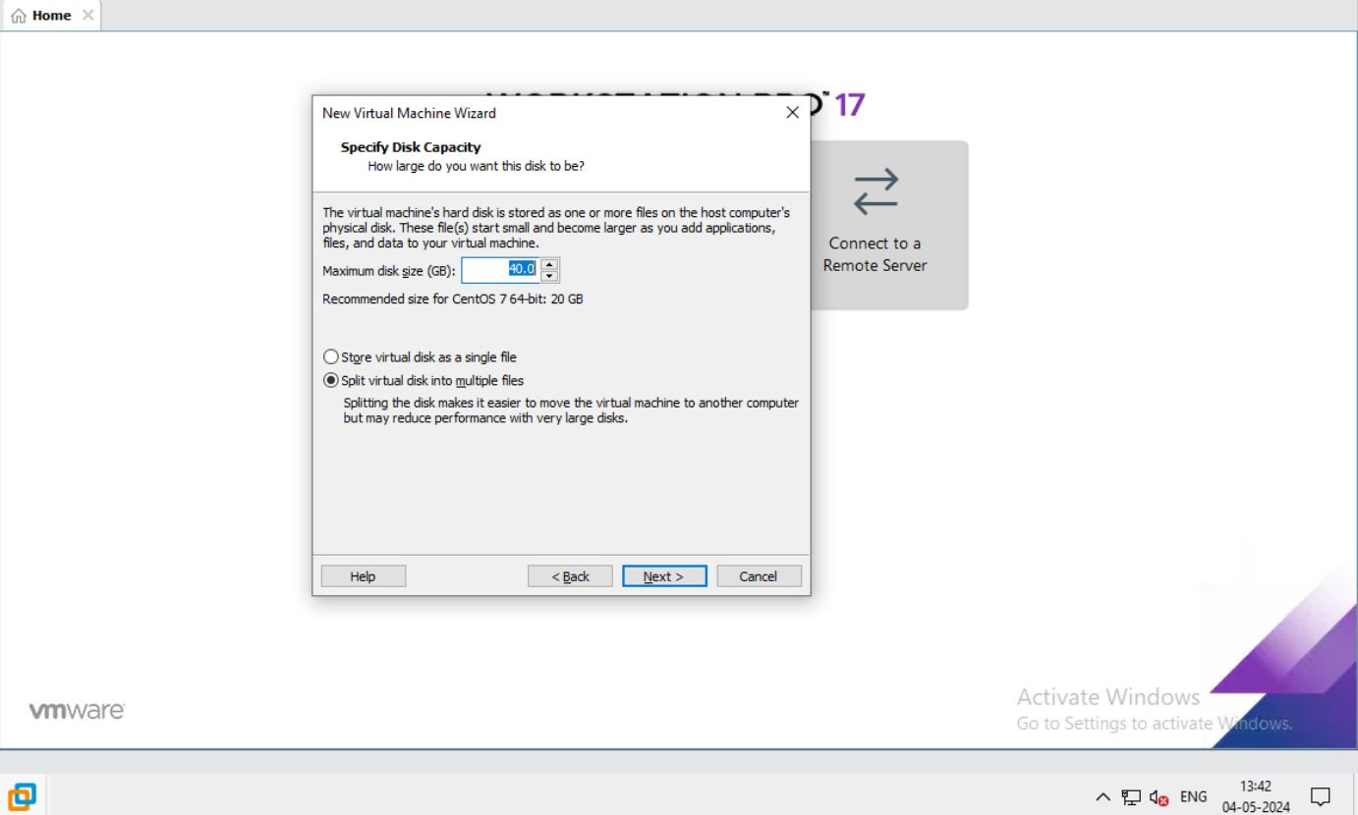
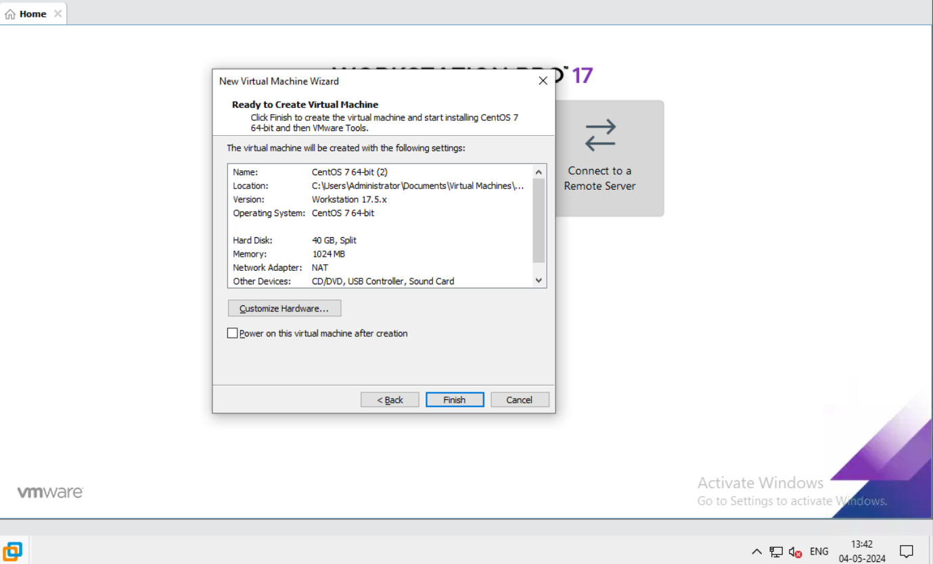
After that here we give Disk size of the machine.
Click Next.
In this step ,our CentOS-7 Virtual machine ready to create.
Then click Next.

Slide 6
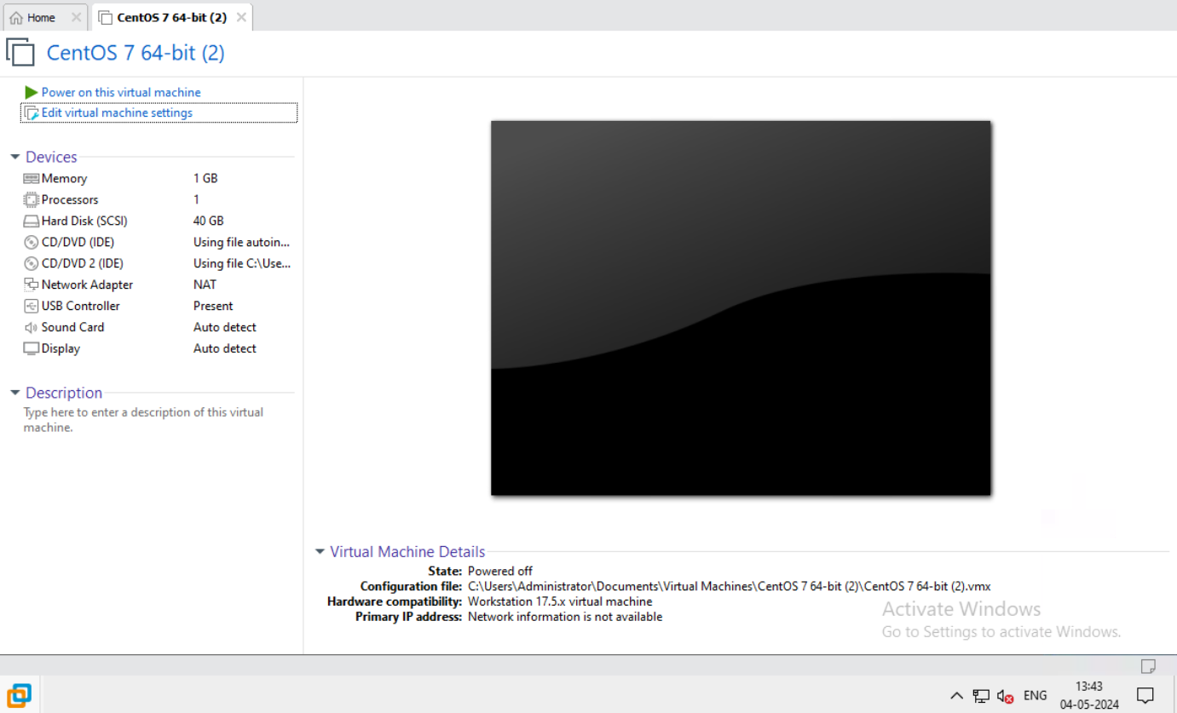
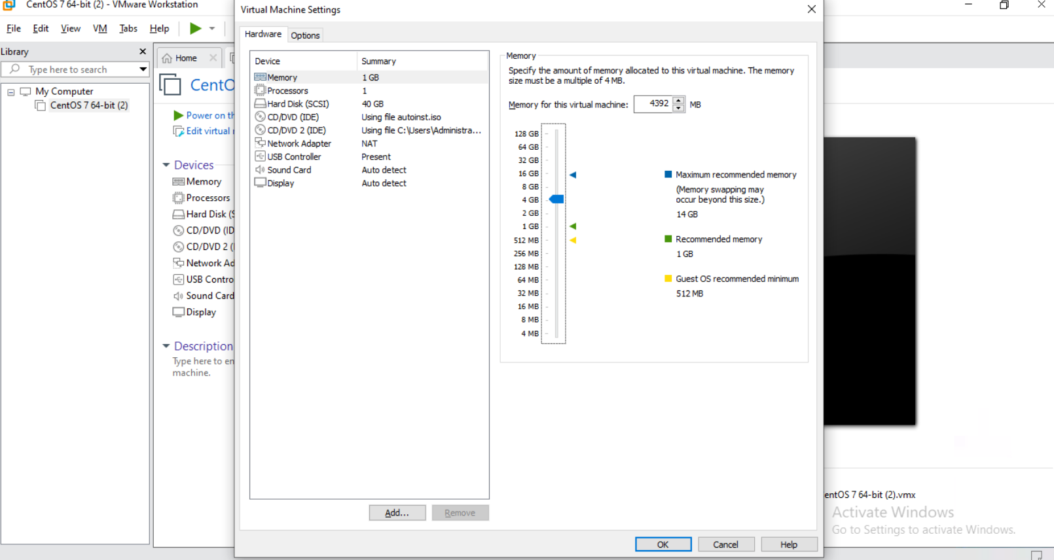
Here is the first step after finished or first look of centOS-7.
After that edit the virtual machine setting.
Here is the first look.

Slide 7
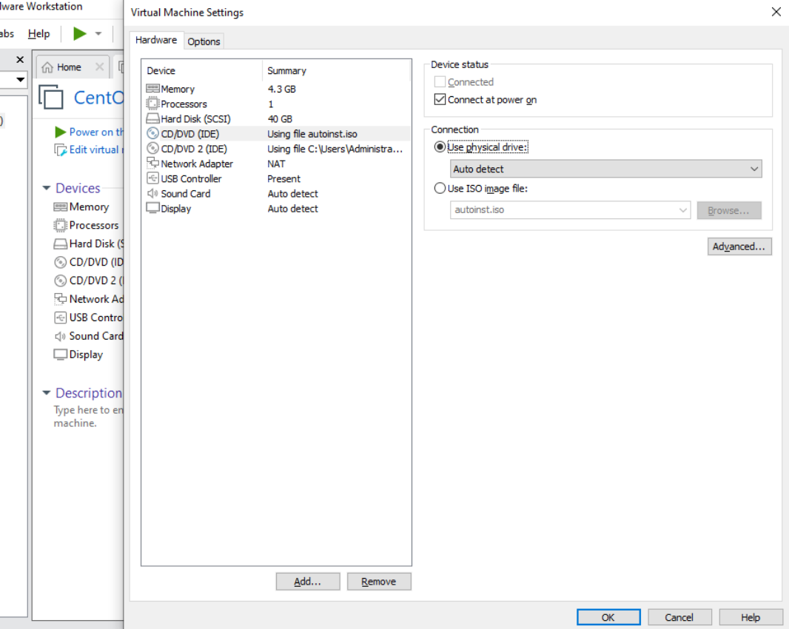
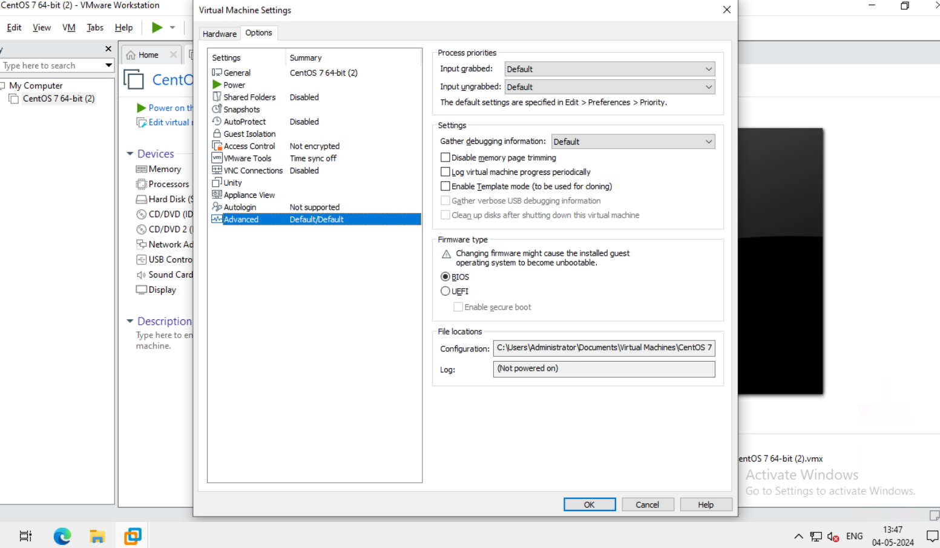
Now go to the CD/DVD Choose physical drive.
Click ok.
Now go to the advance choose BIOS.
Click ok.

Slide 8
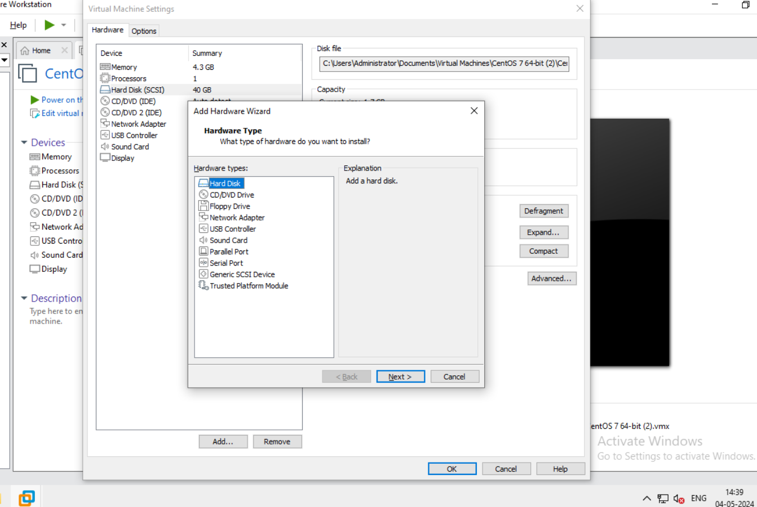
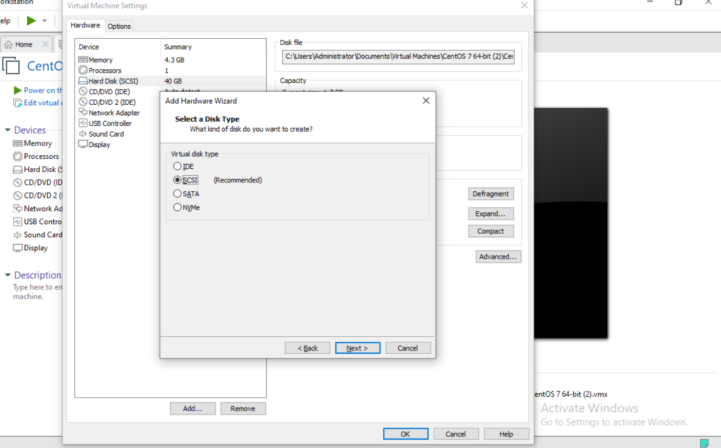
This is 3 hard disk partition , so we add 3 hard disk.
Here is the first look of the hard disk add.
Now I choose default disk type that is SCSI.
Click next

Slide 9
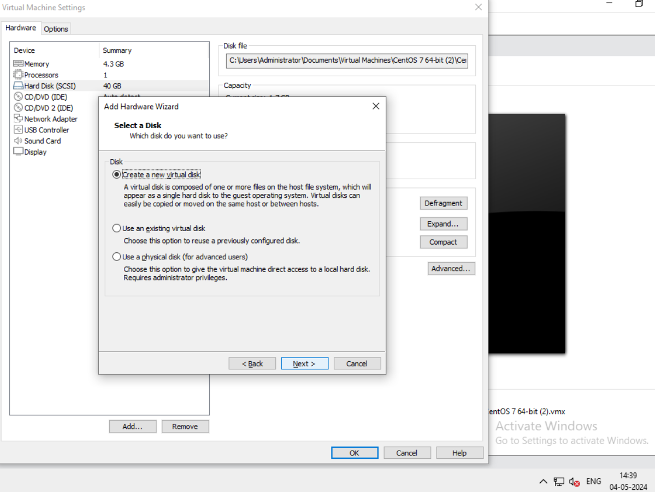
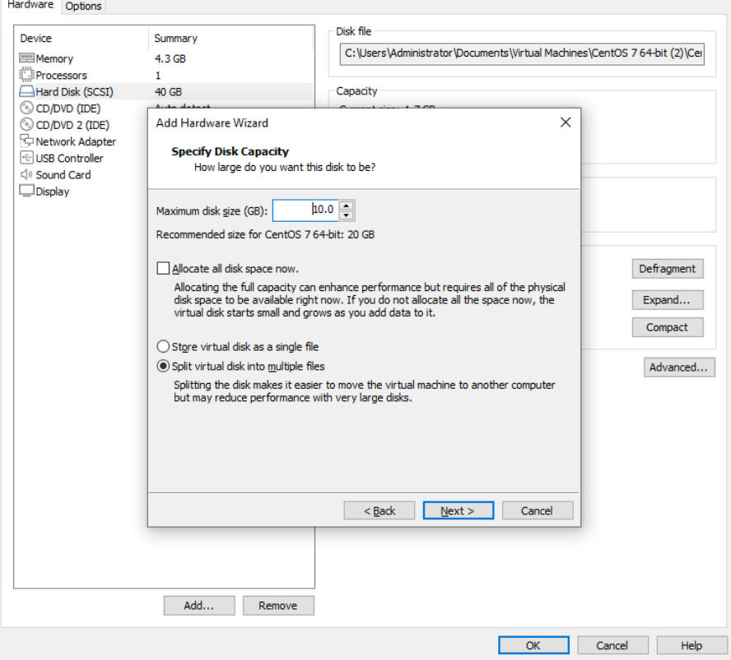
Here we add Disk type ,choose default disk.
Click next.
Here we give the capacity of the disk .
Then Click next.

Slide 10
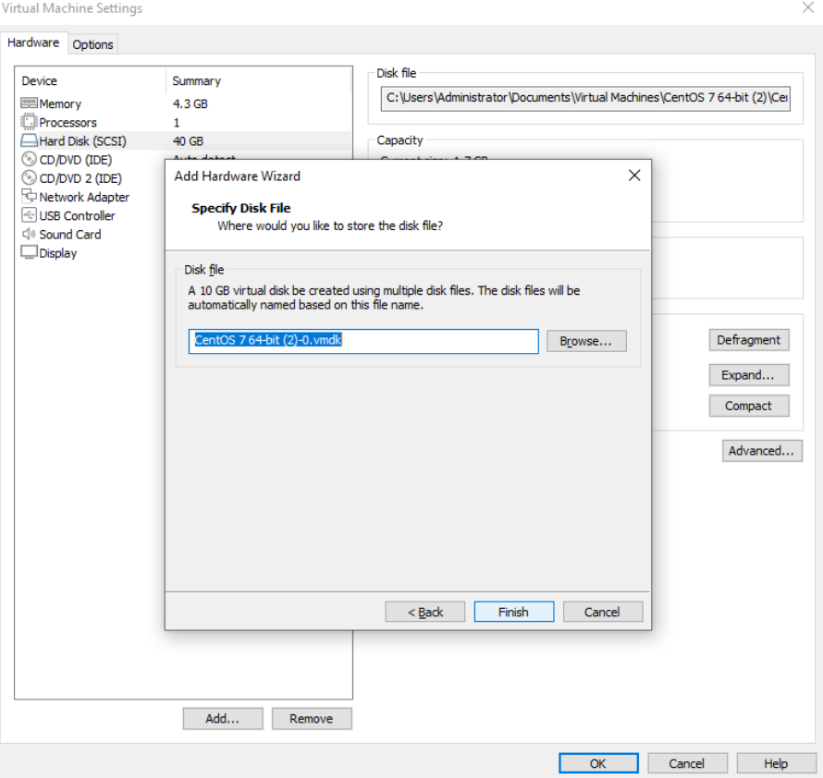
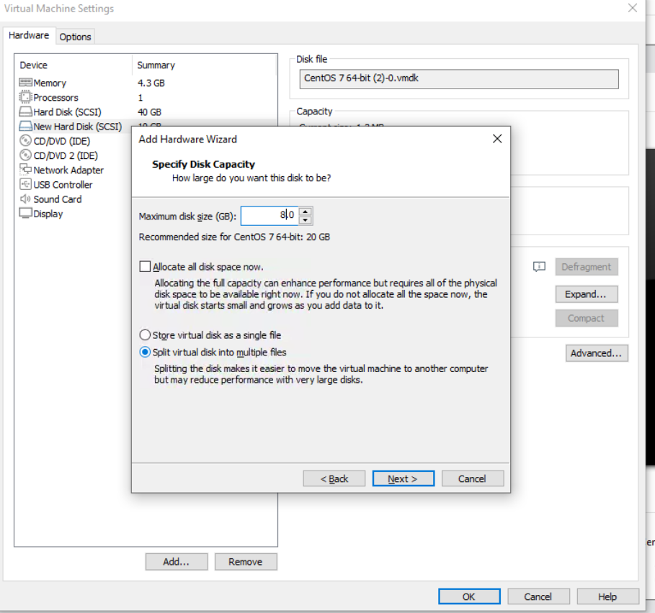
Here we specify the disk file.
Then click on finished.
Now, create another 2 disk ,This is the 2nd disk of size 8GB.
Here we specify disk capacity.

Slide 11
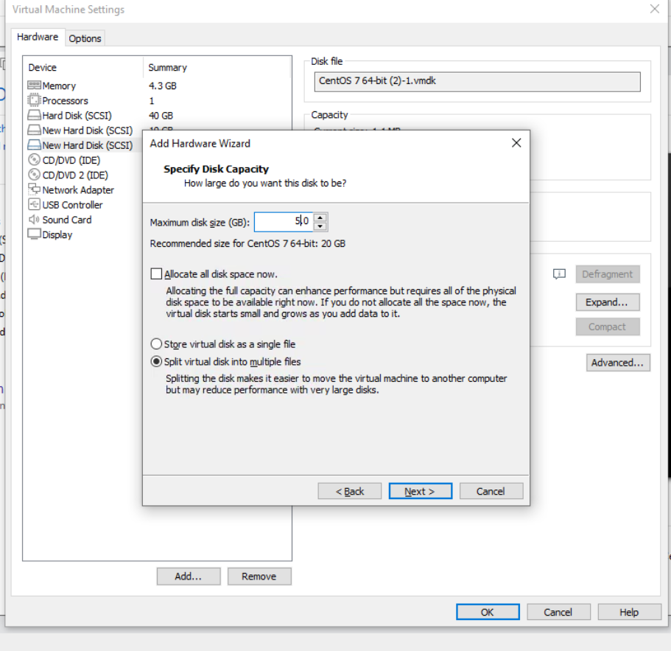
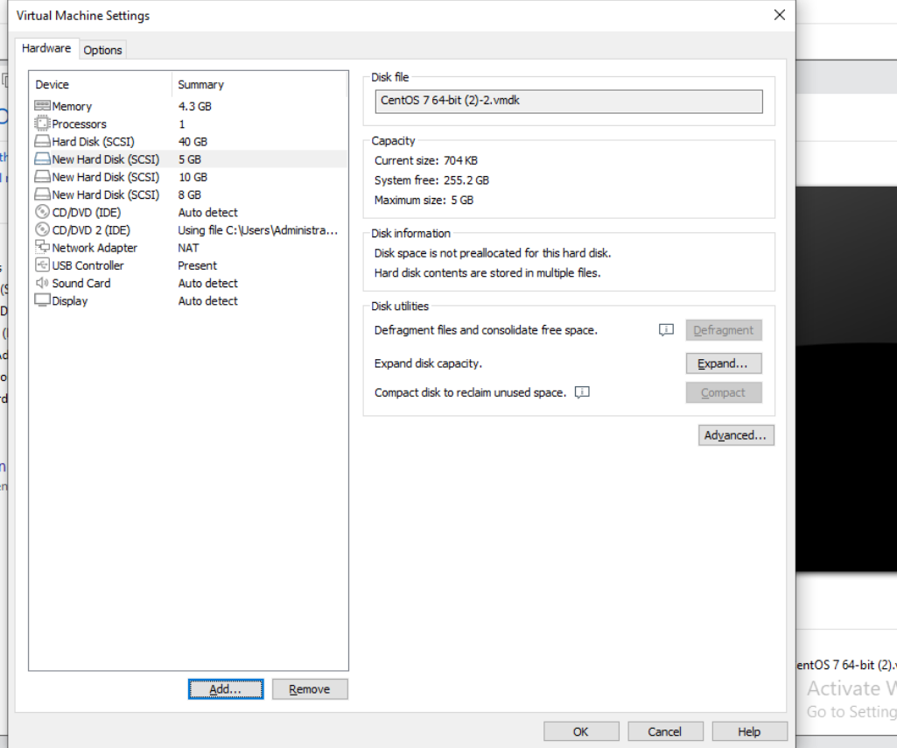
Here we another disk of size 5GB.
Here the first look after doing all edit work in setting .
Then click ok.

Slide 12
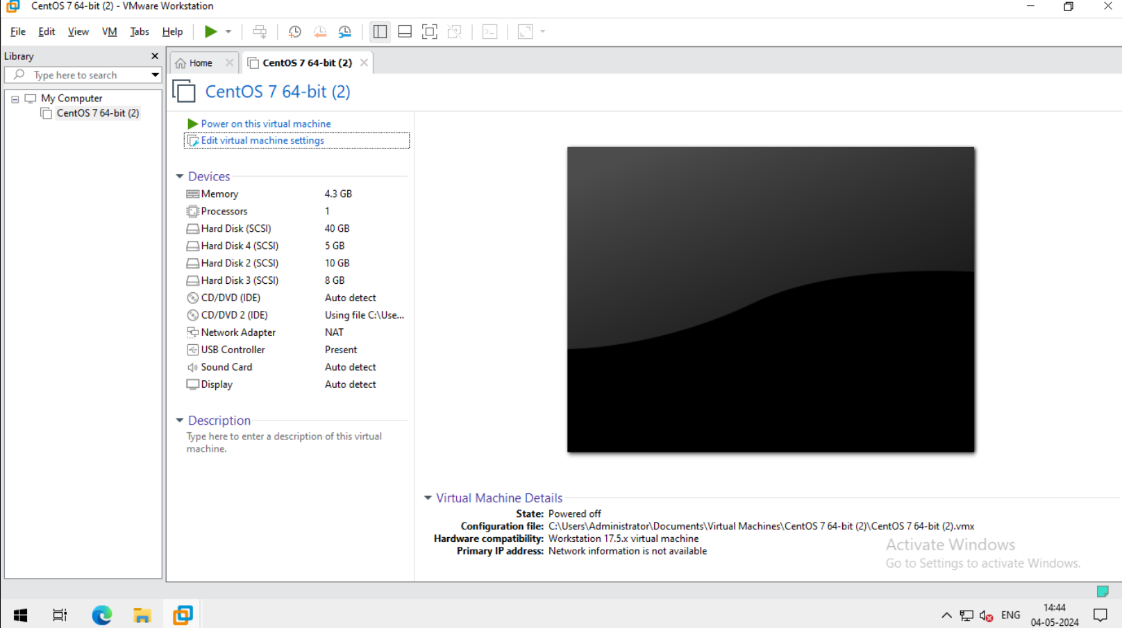
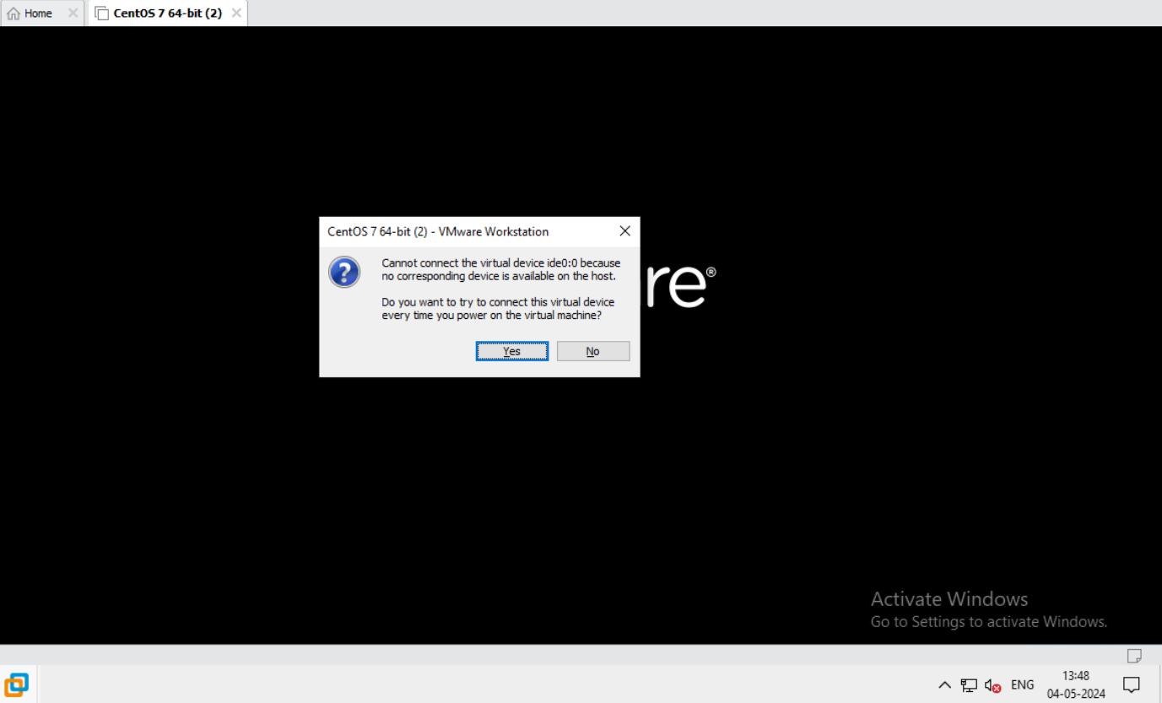
Here is the first look of vm after edit setting.
Now we start the virtual machine and click on yes.

Slide 13
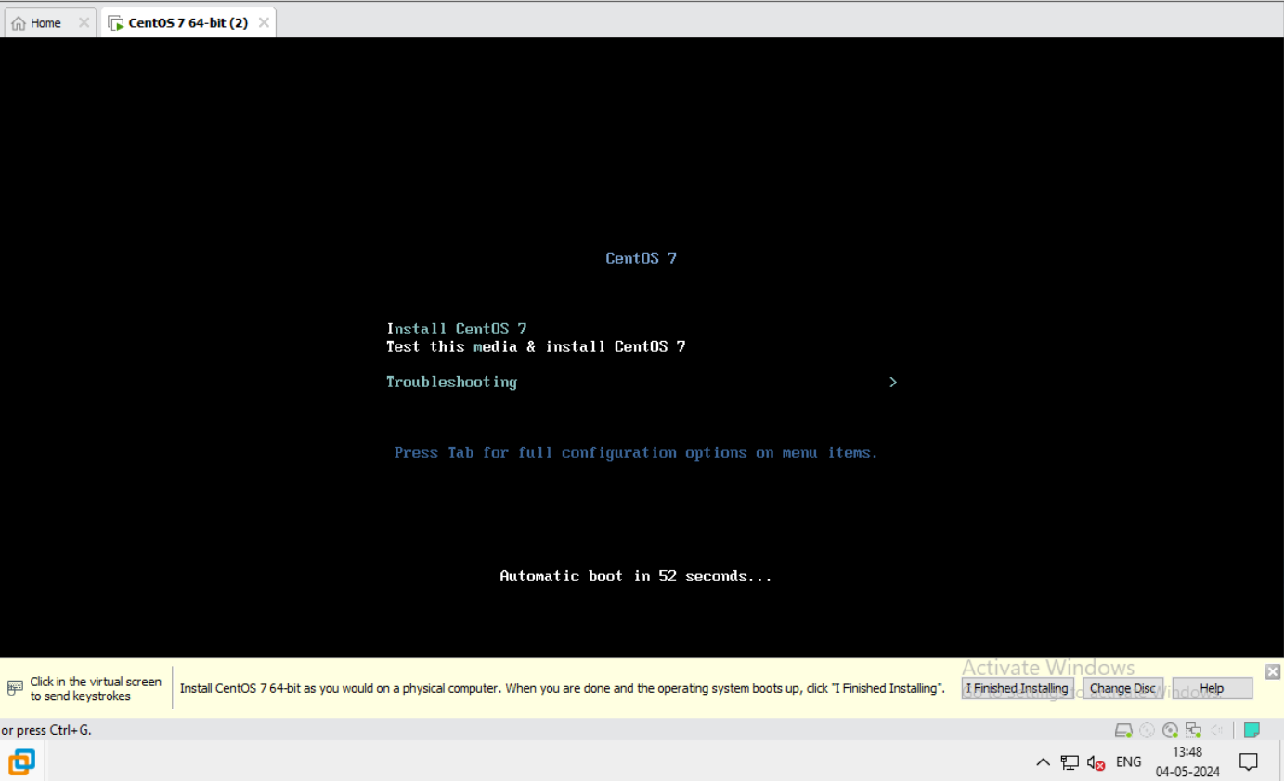
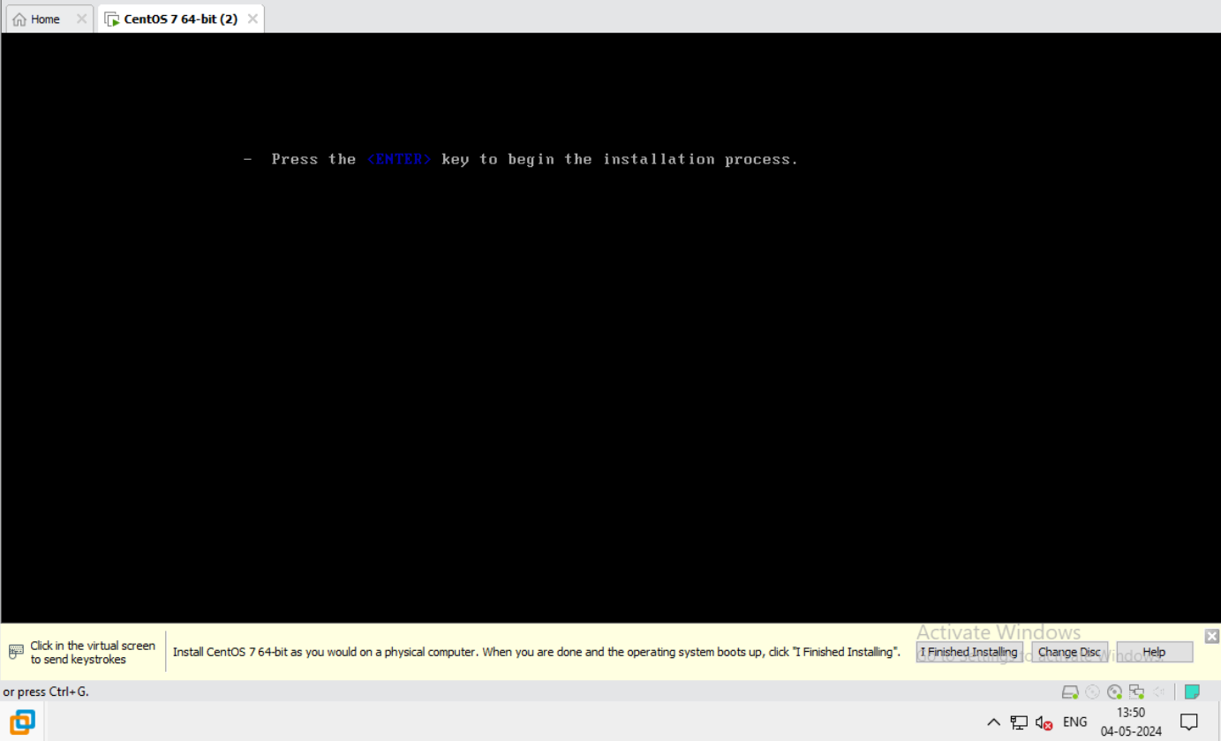
Now I choose the first option centOS 7.
It take time for next step.
Now we press on enter to start the configuration.

Slide 14
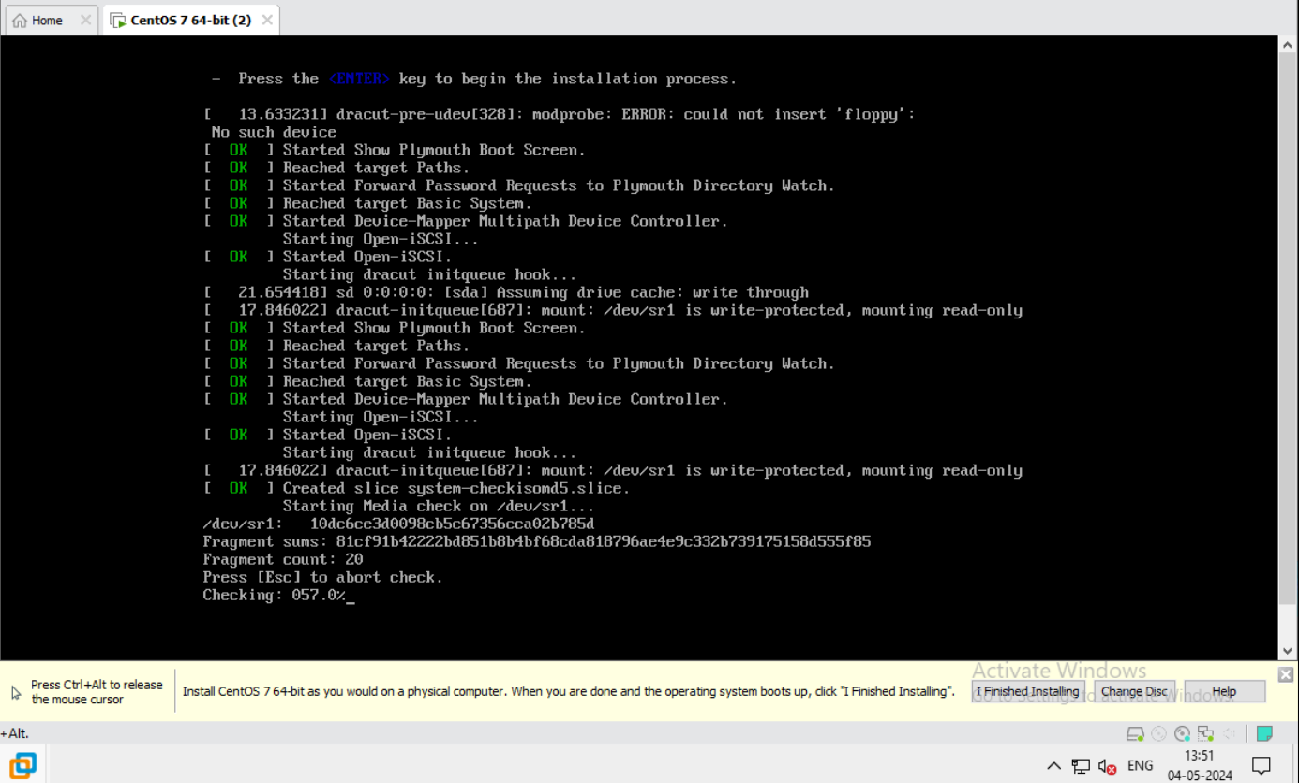
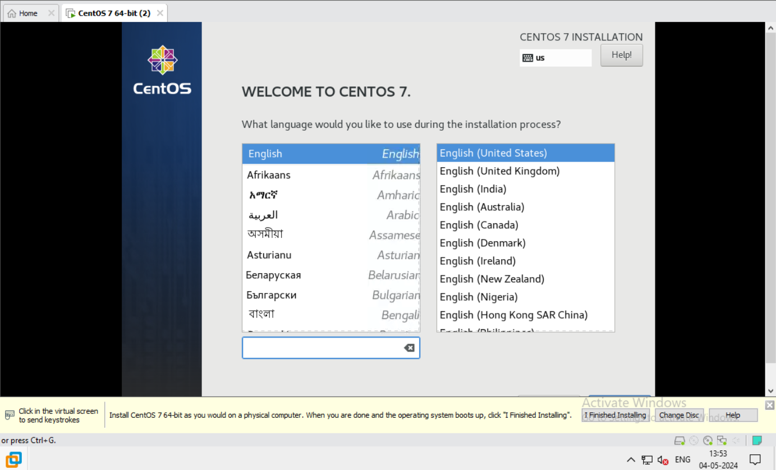
This is the configuration page.
Now we choose the language and choose English.
Click on next

Slide 15
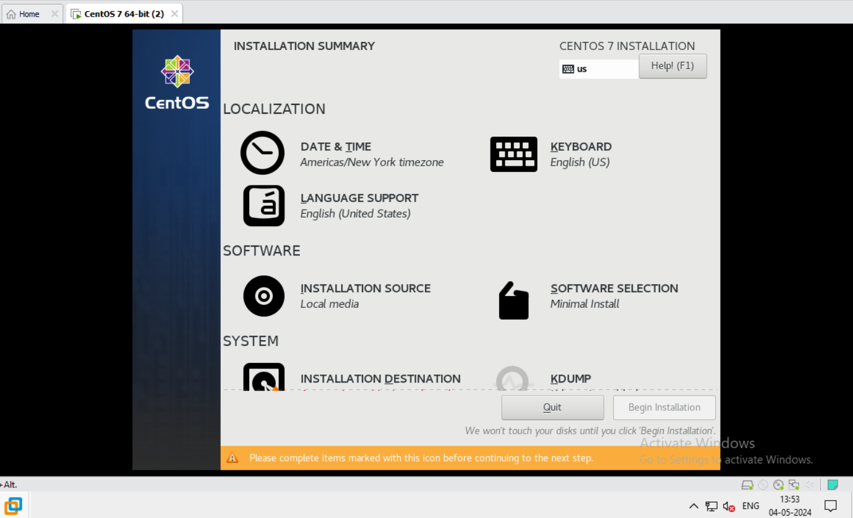
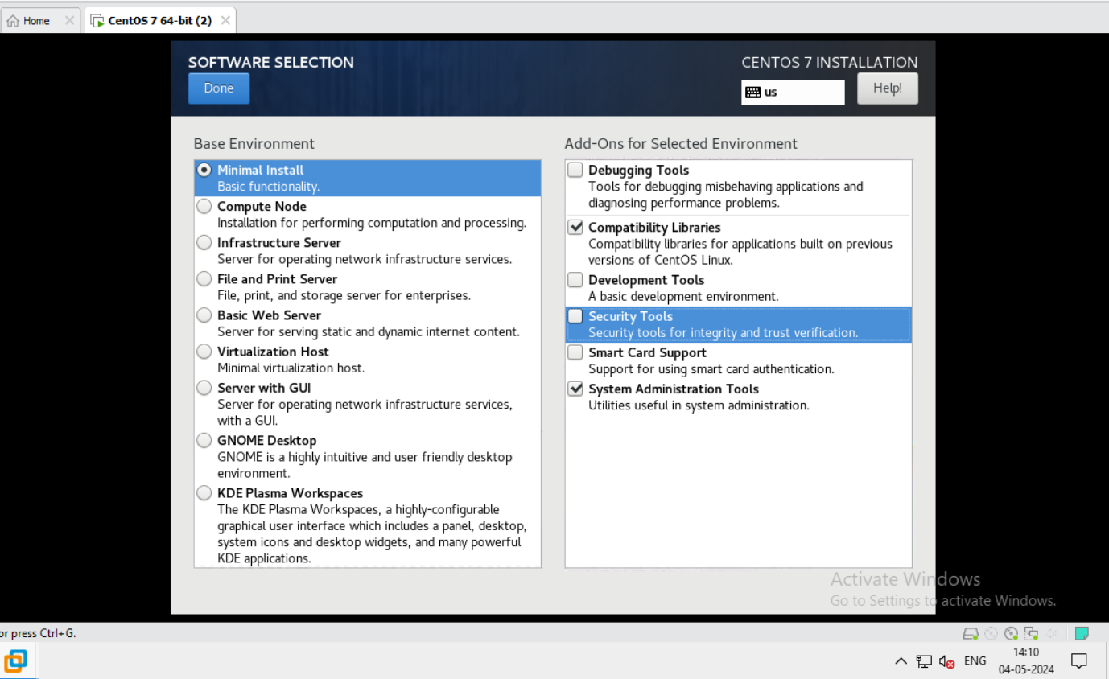
Now Software selection of minimal install.
Click on software selection.
Now choose minimal install and Right hand side choose compatibility libraries and system administration tool.
Click on done.

Slide 16
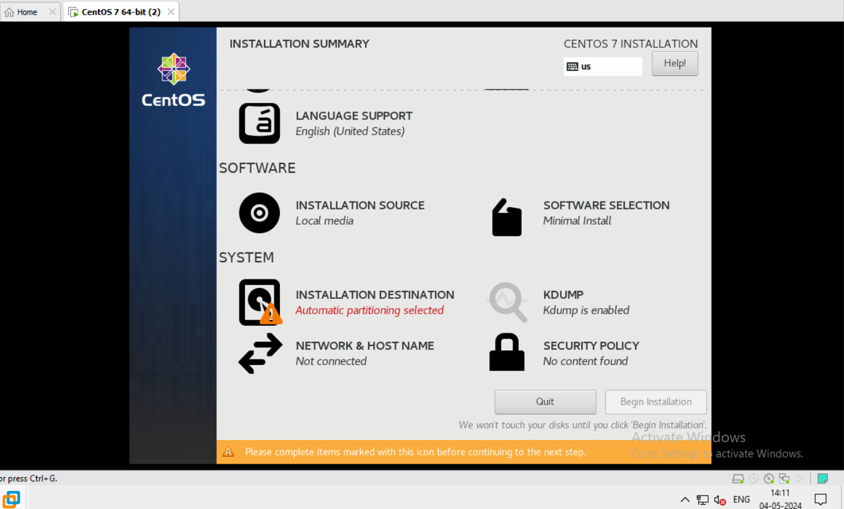
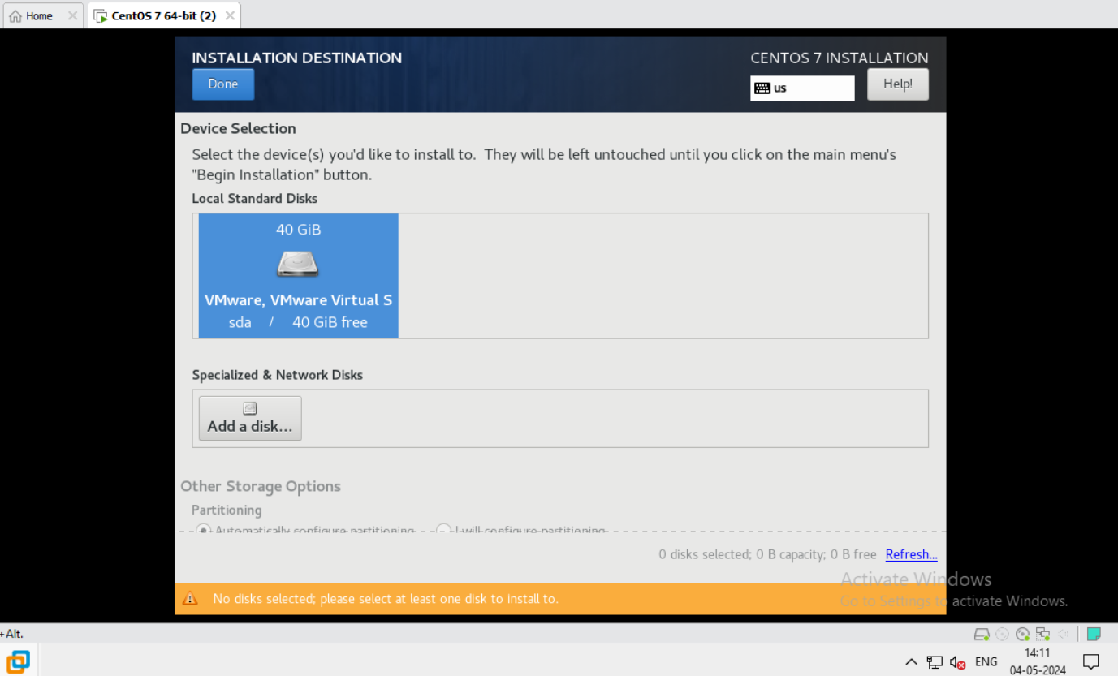
Now click on Installation Destination.
Now click on local standard disk.
Click on done.

Slide 17
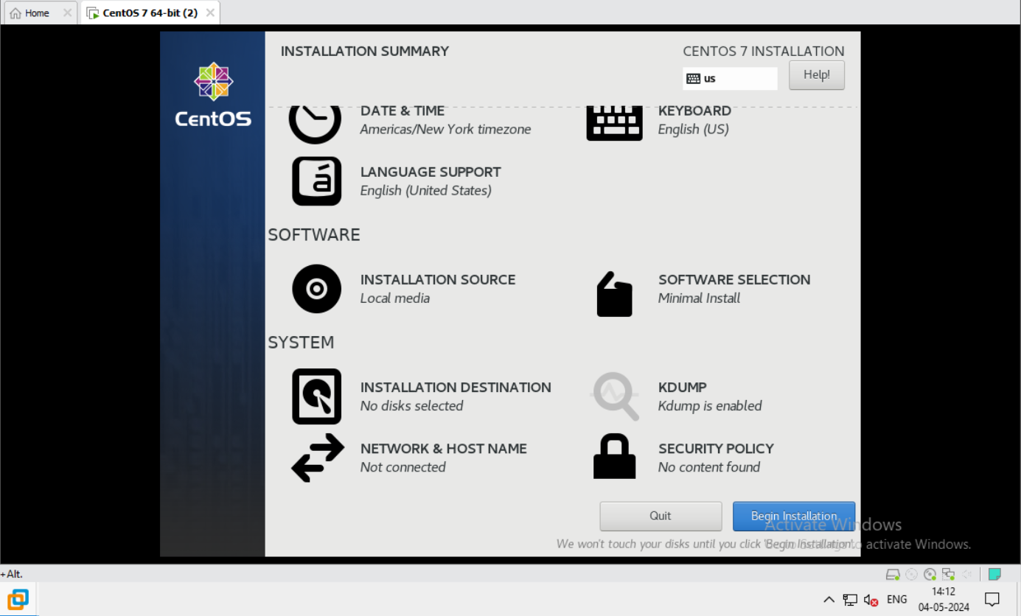
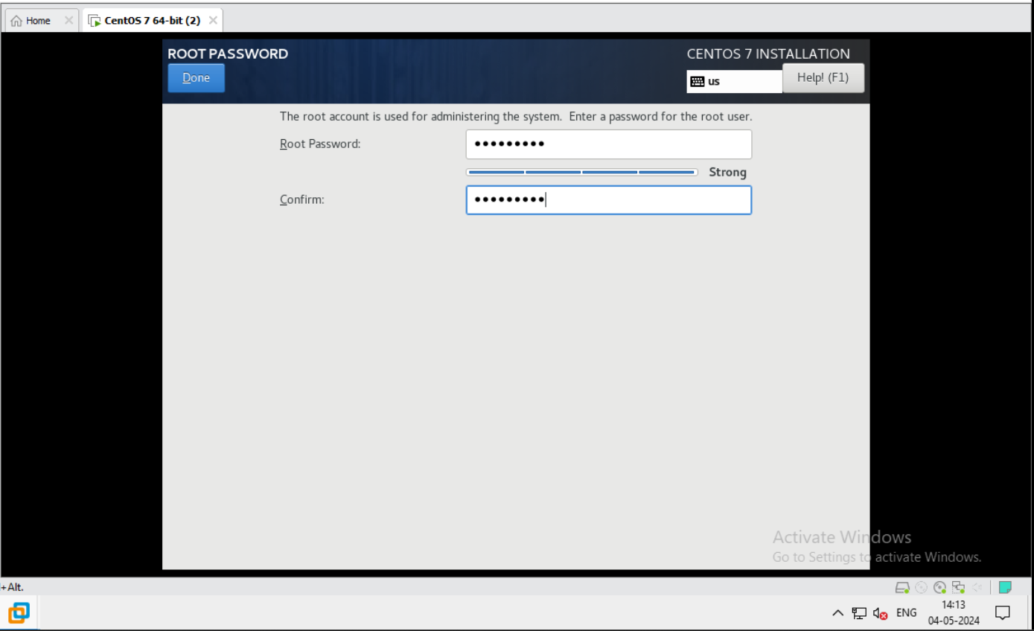
Now system is ready to begin install.
Click on begin install.
Now set the root password.

Slide 18
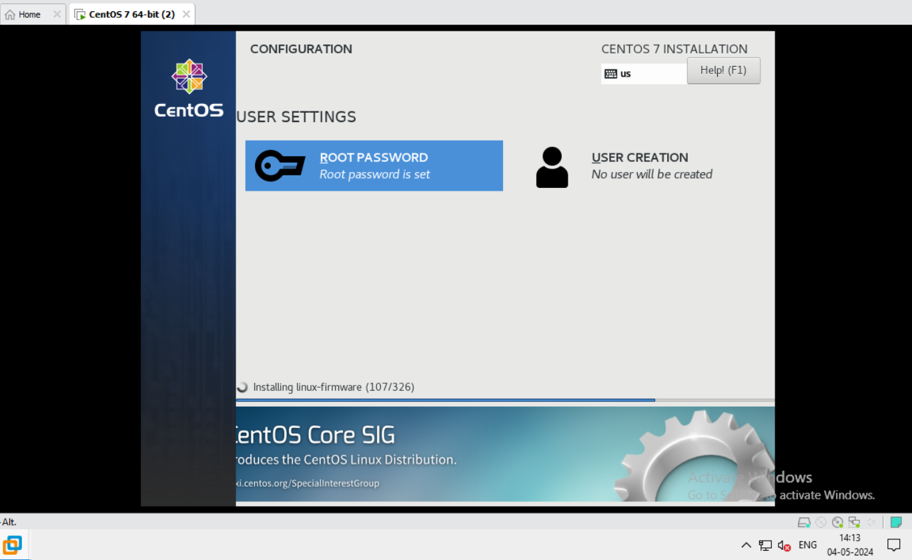
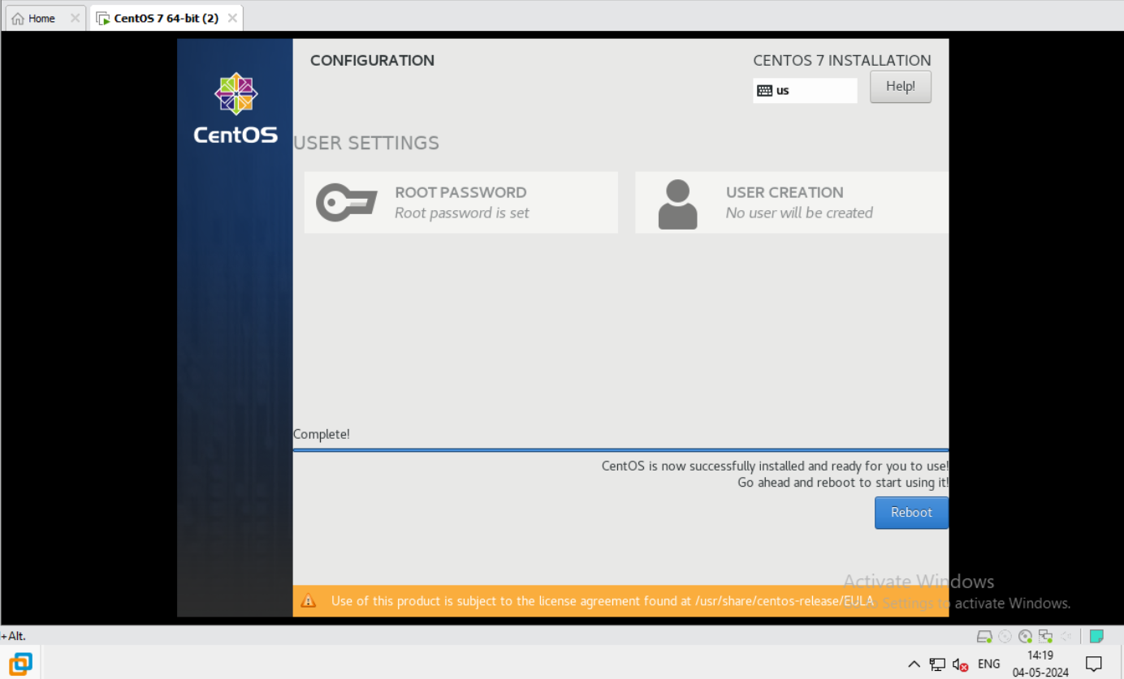
Now installing linux-firmware.
It’s take time.
Now we reboot the system.

Slide 19
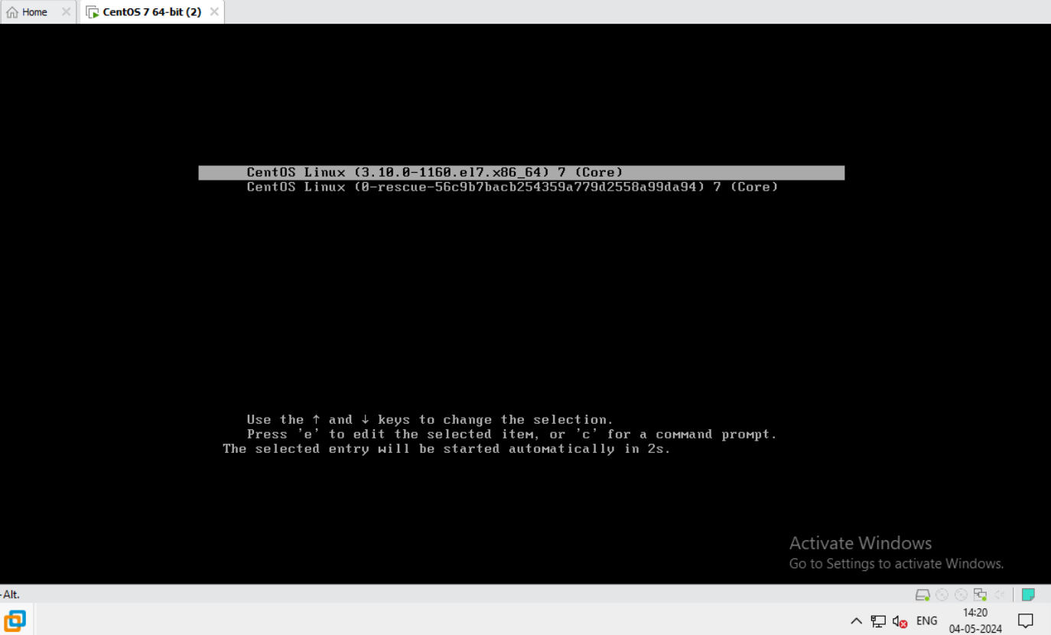
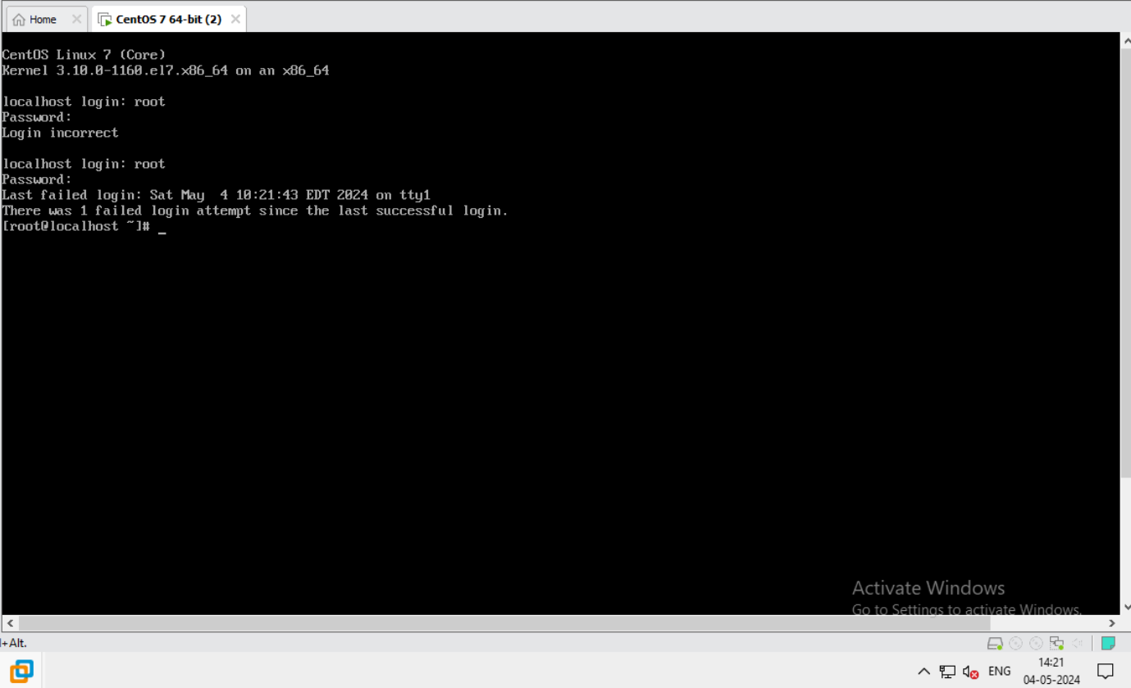
First step after installation.
Now we login with root.
And give the root password.

Slide 20
Here is the step of LVM configuration.
Partition physical storage
2.Create a physical volume(PV).
And PV are used to register underlying physical devices for use in volume groups.
3.Create a volume group(VM).
VM are storage pools made up of one or more physical volume.
One pv can only be allocated to single Vg.
4.Create a logical volume(VM).
Logical volume are created from physical extends in a vg.
5.Make mount point.
6.Make file system.
7.mount.
Create partition:
fdisk /dev/sdb
n
Change Linux partition to LVM. 8e HEX code(press t).

Slide 21
W
Partprobe /dev/sdb
Fdisk –l
2. Create a physical volume.
pvcreate /dev/sdb1
pvdisplay
3.Create a volume group.
vgcreate name /dev/sdb1
vgdisplay
4.Create logical volume.
lvcreate –n part1 –L +500M name
lvcreate –n part2 –L +250M name
lvdisplay
5.Make mount point.
mkdir /forpart1 /forpart2

Slide 22
6. Make file system.
mkfs –t /dev/name/part1
mkfs –t /dev/name/part2
7. Mount /dev/name/part1 /forpart1
mount /dev/name/part2 /forpart2
8.Put enteries in /etc/fstab file for mounting permanently.
9. Mount –a will show all mount point.
df -h
10. Extend LVM:
lvextend –L +50M /dev/name/part1
removing LVM:
unmount forpart1
Or
For remove
lvremove /dev/name/part1
vgremov name
pvremove /dev/sdb1
Now I insert my code.

Slide 23
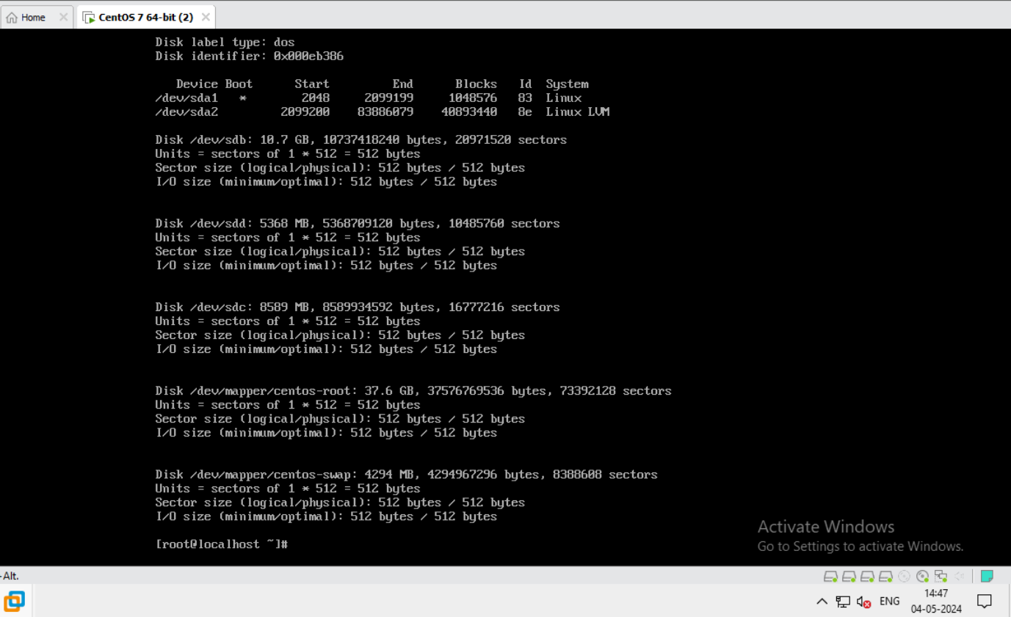
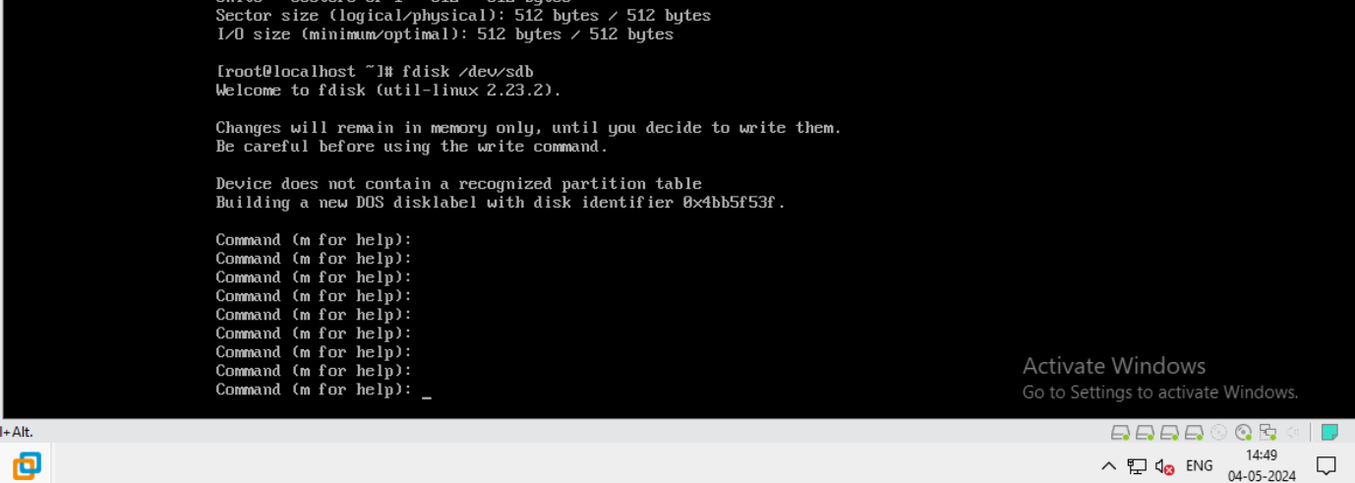
Here we create partition.
Here command for help m is show for helping partition.

Slide 24
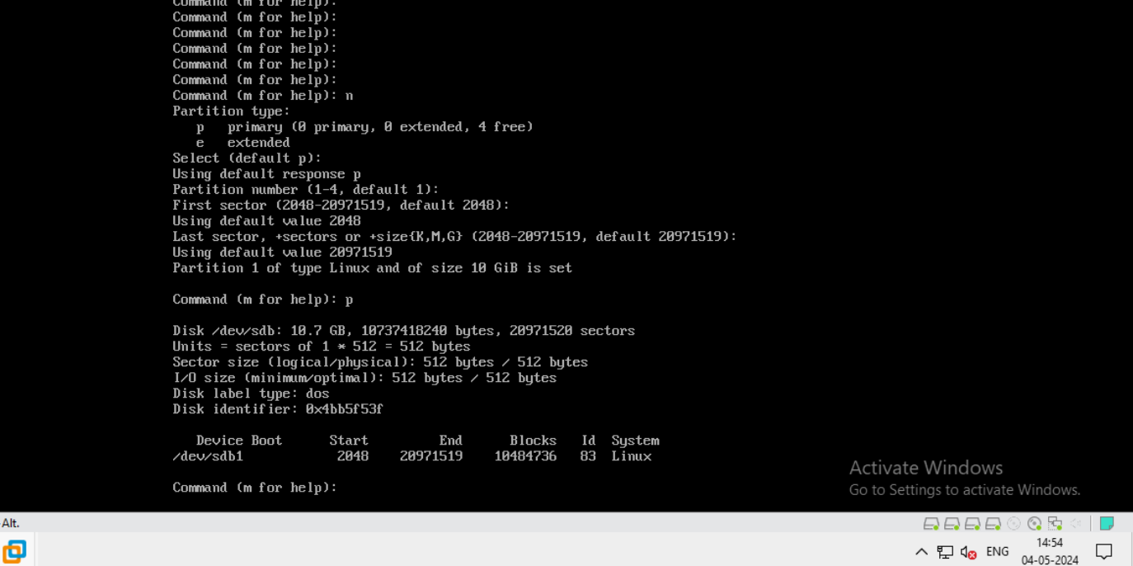
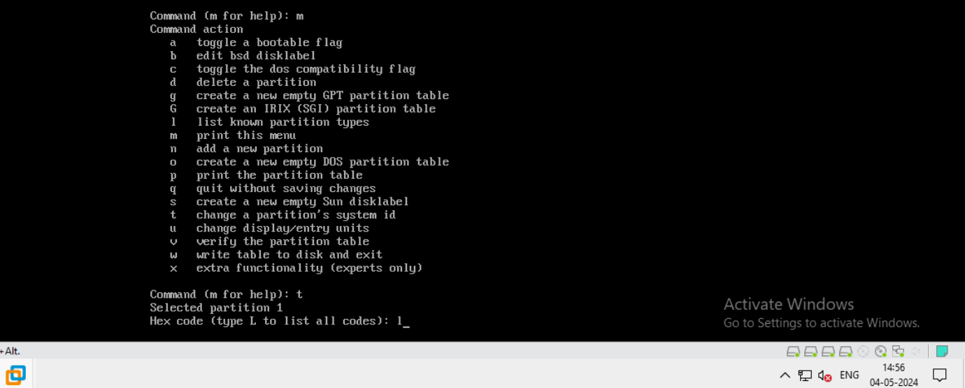
Here we press n for showing partition type and for assign hex code we press t.
It’s showing all hex code and in here we see our hex code.

Slide 25
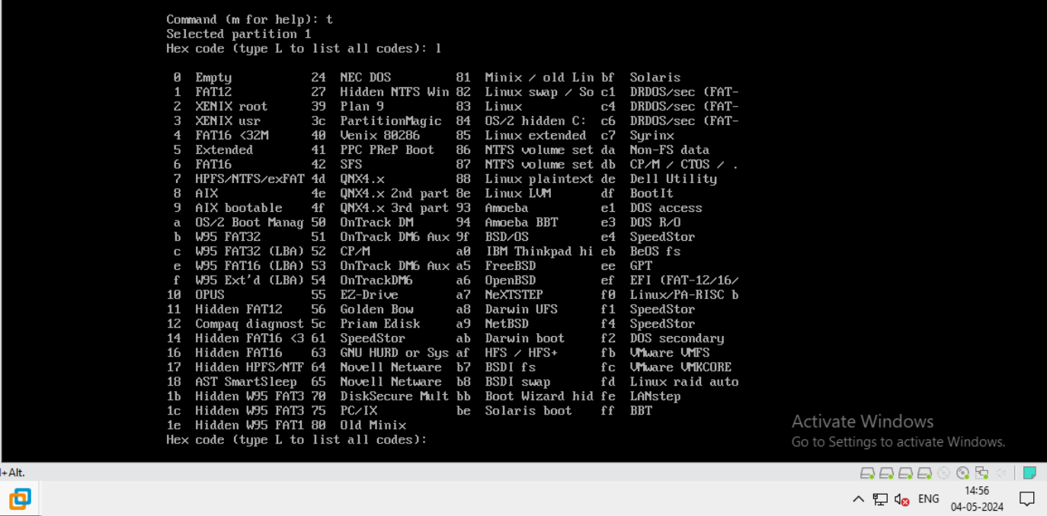
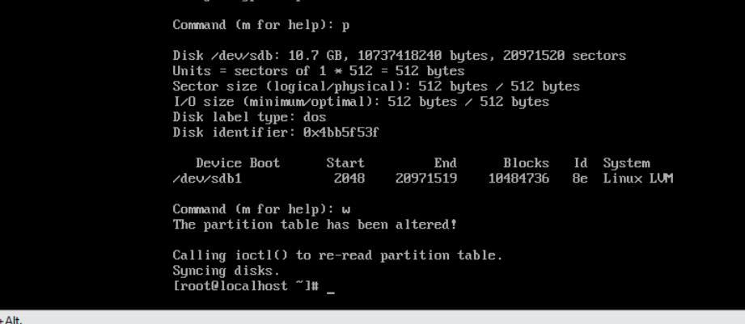
Here we see the all hex code and apply hex code to convert system linux to linux LVM.
Then we press w for save the partition.

Slide 26
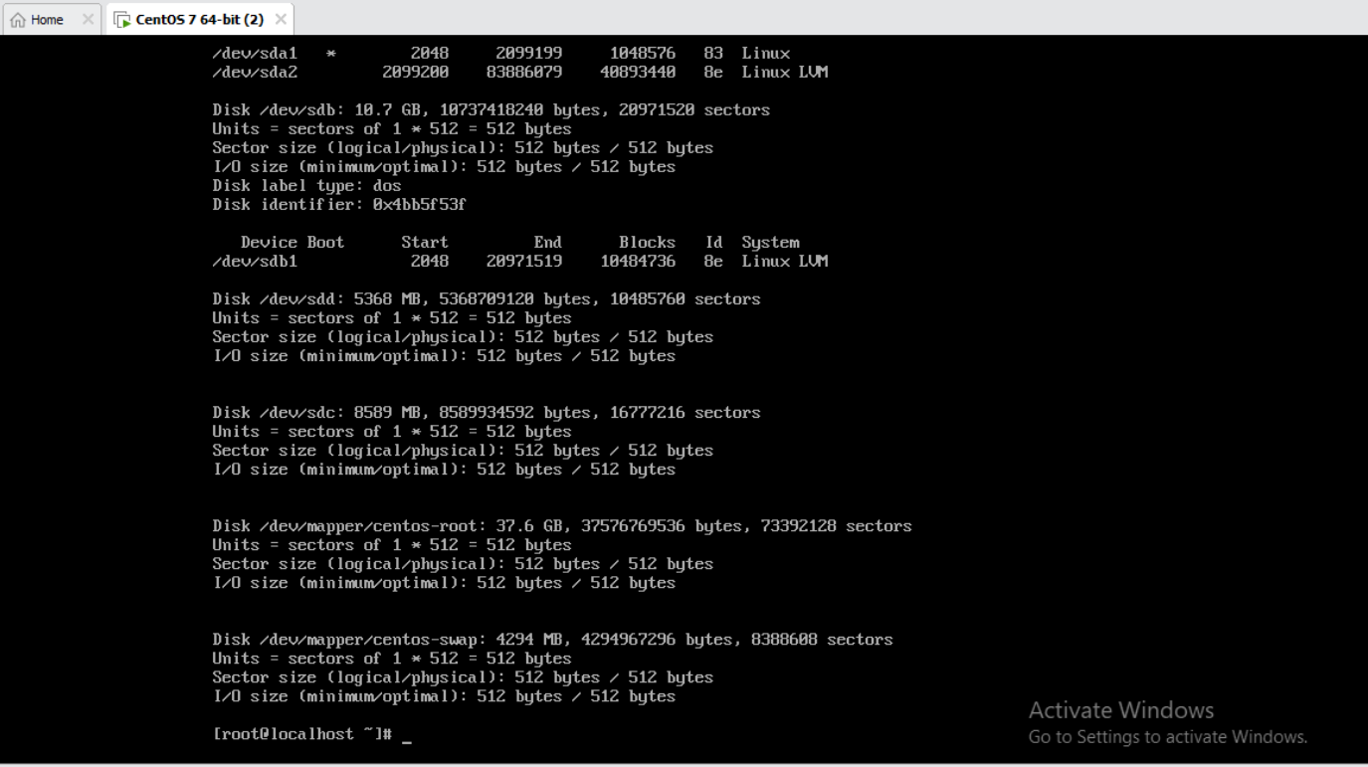
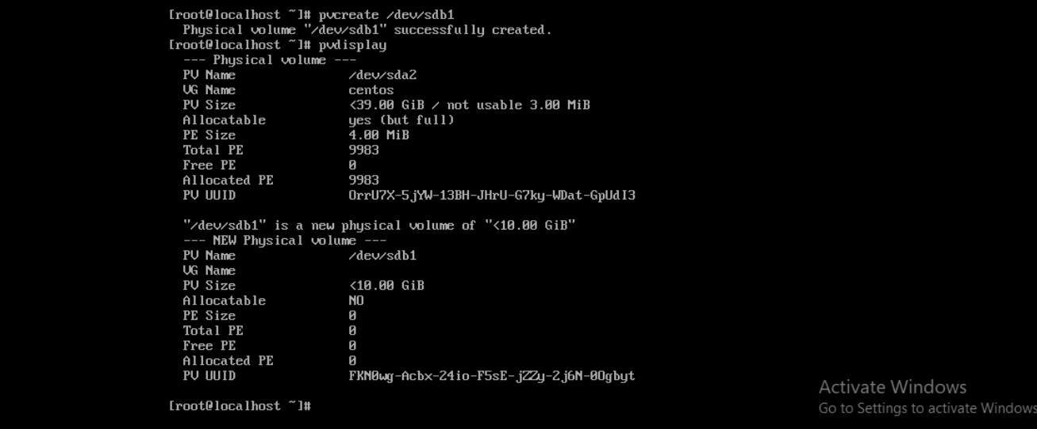
Here we create physical volume.
Display the volume by the help of pvdisplay.

Slide 27
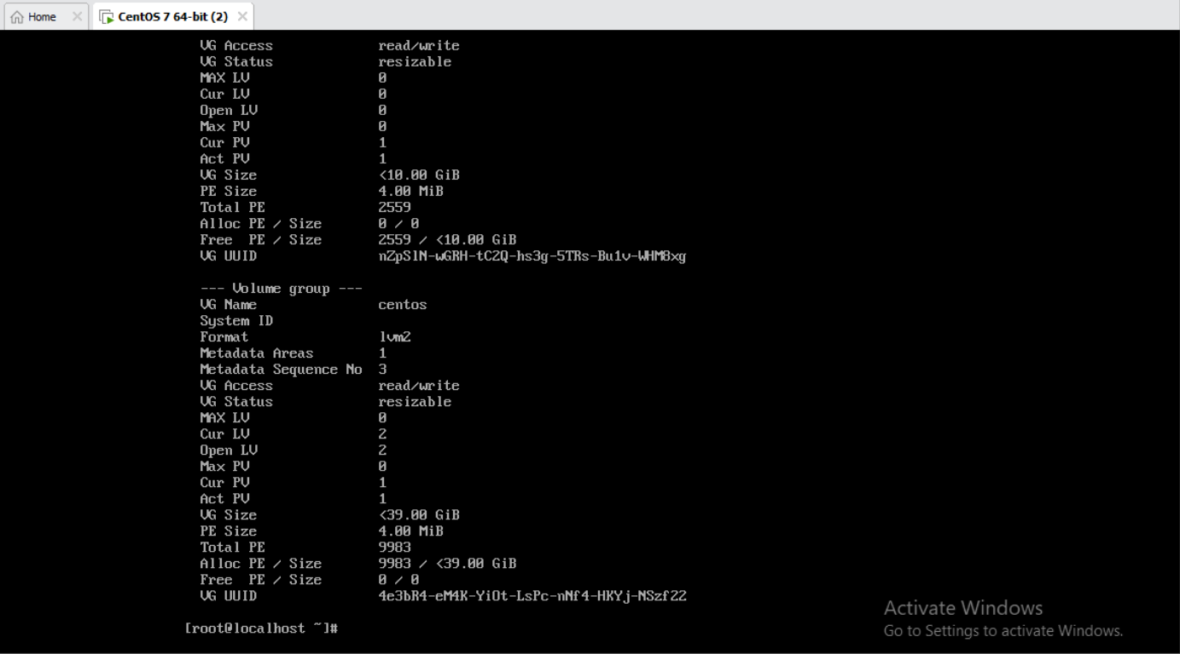
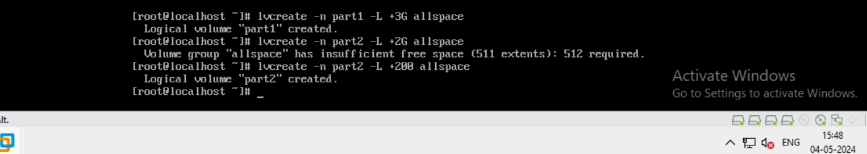
Here we create logical volume by the help of lv create and assign name part1 & part2.
The creation in 2nd slide.

Slide 28
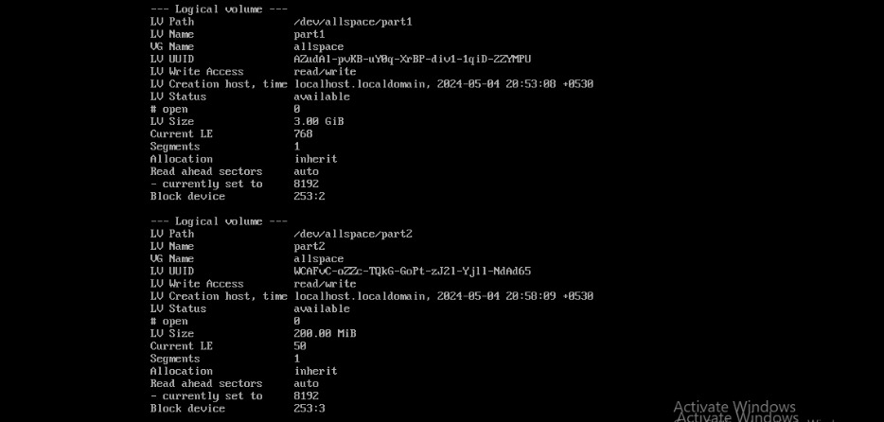
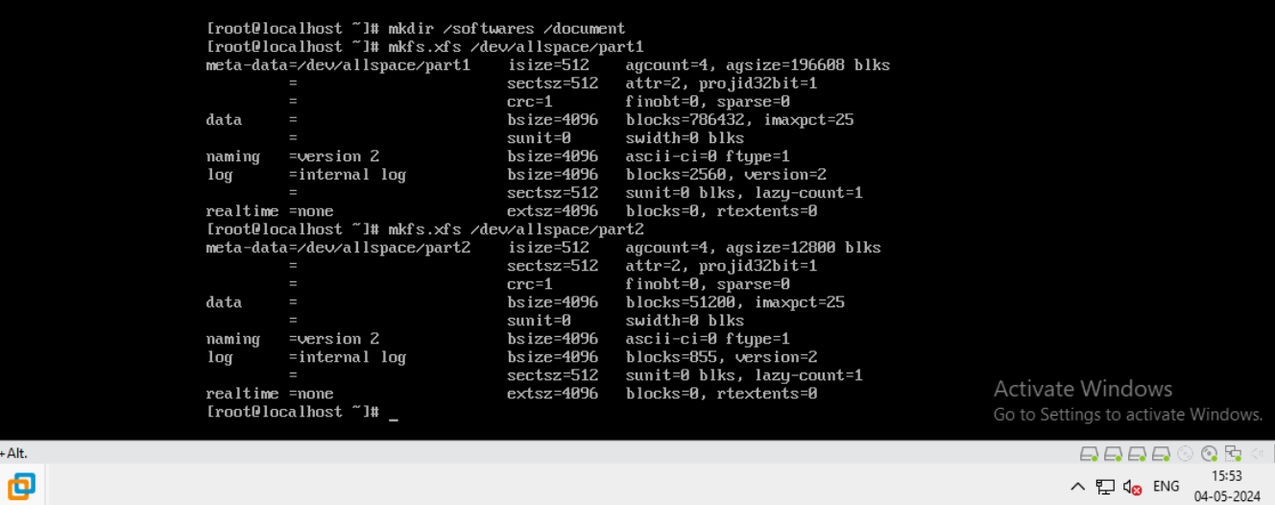
In first slide we see our created logical volume named by part1 and part2.
Here we create mount point by the help of mkdir command and also make file system.

Slide 29
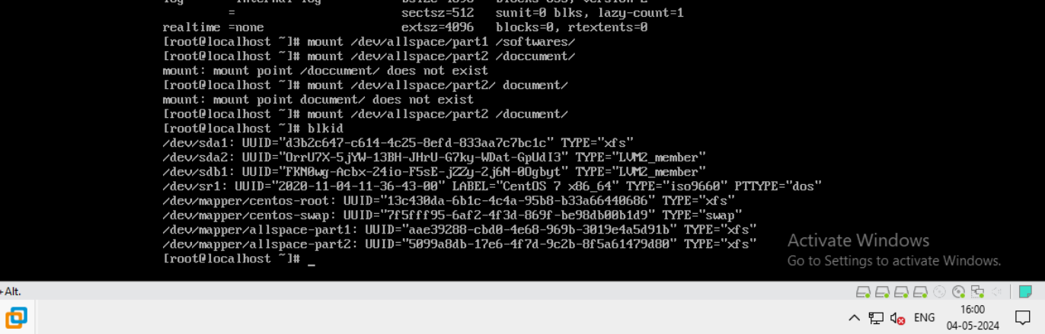
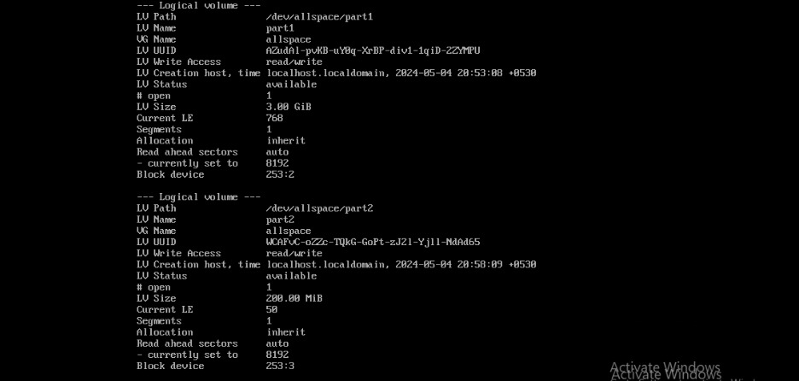
Here we assign the mount value and
Display the logical volume.
2nd slide display the volume .

Slide 30


Here show the logical volume
And extend the logical volume.

Slide 31


Here we create another volume group first run fdisk
Then for more option m is showing then we created.

Slide 32


Here we run df –h for showing all mount point.
In 2nd slide display the all mount point.

Slide 33
Thank you
Kishor Chandra sahoo

